Slide 1
BREST CANCER CALSSIFICATION USING SUPPORT VECTOR MACHINE
MACHINE LEARNING

Slide 3
BREST CANCER RESEARCH
https://www.researchgate.net/publication/271907638_Breast_Cancer_Detection_with_Reduced_Feature_Set
https://archive.ics.uci.edu/ml/datasets/breast+cancer

Slide 4
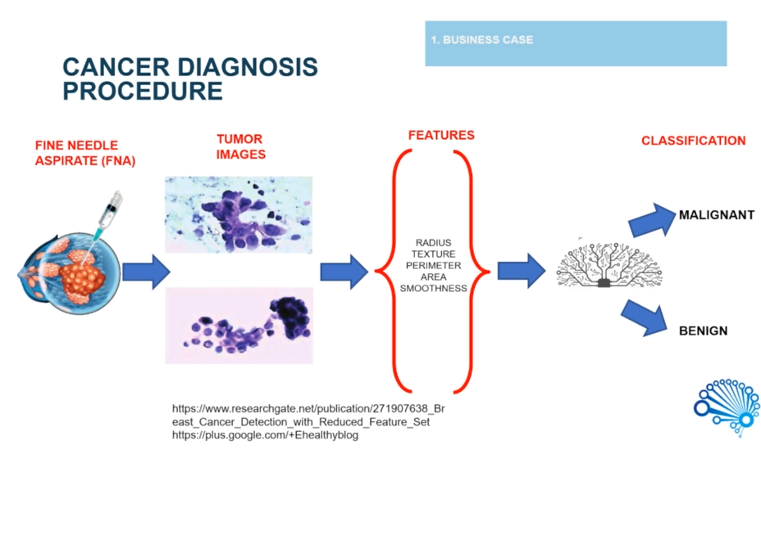
CANCER DIAGNOSIS PROCEDURE

Slide 5
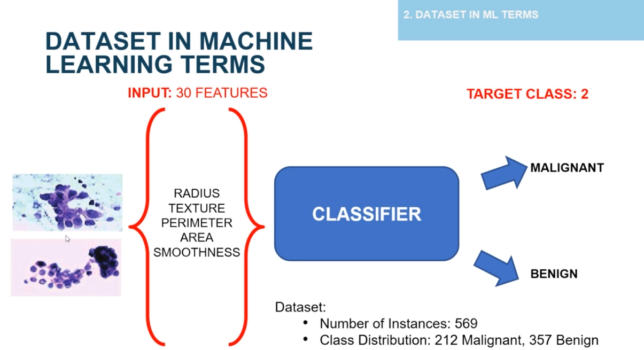
DATASET IN MACHINE LEARNING TERMS

Slide 6
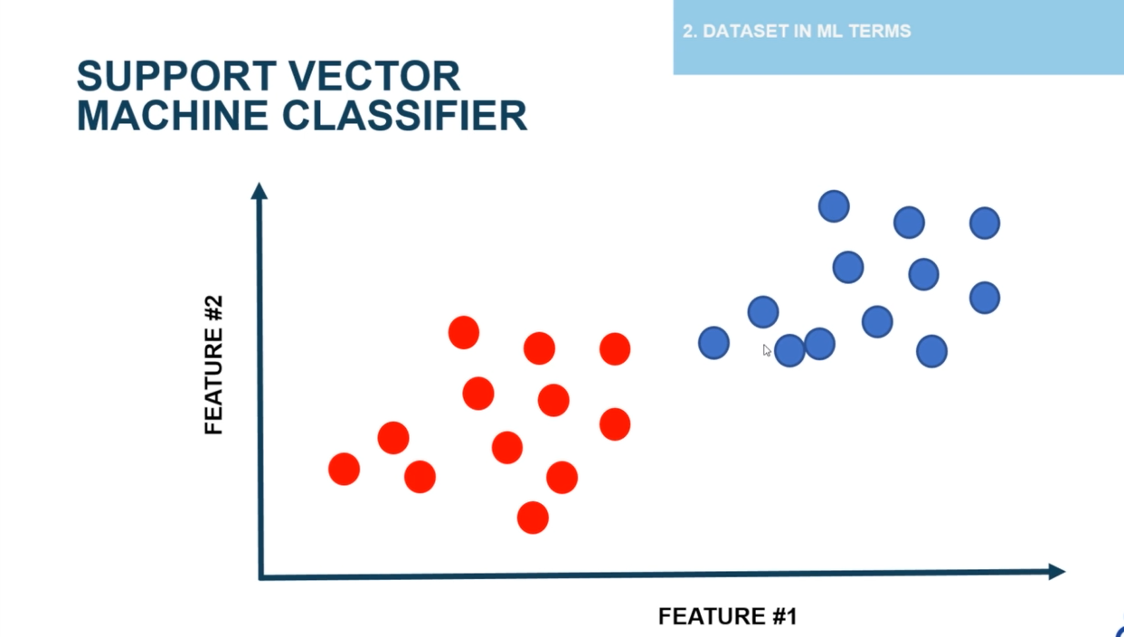
SUPPORT VECTOR MACHINE CLASSIFIER

Slide 7

SUPPORT VECTOR MACHINE CLASSIFIER

Slide 8
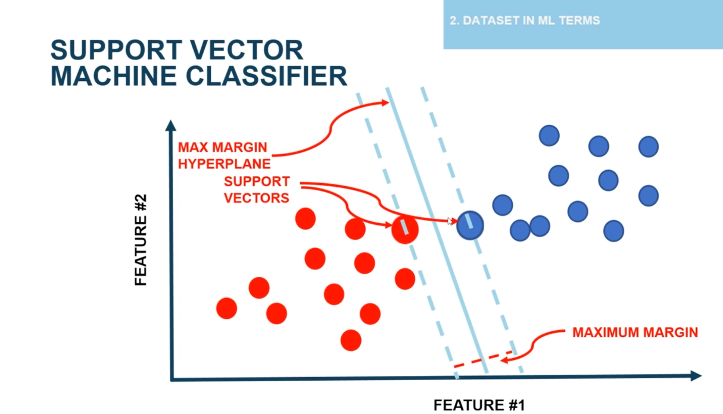
SUPPORT VECTOR MACHINE CLASSIFIER

Slide 9
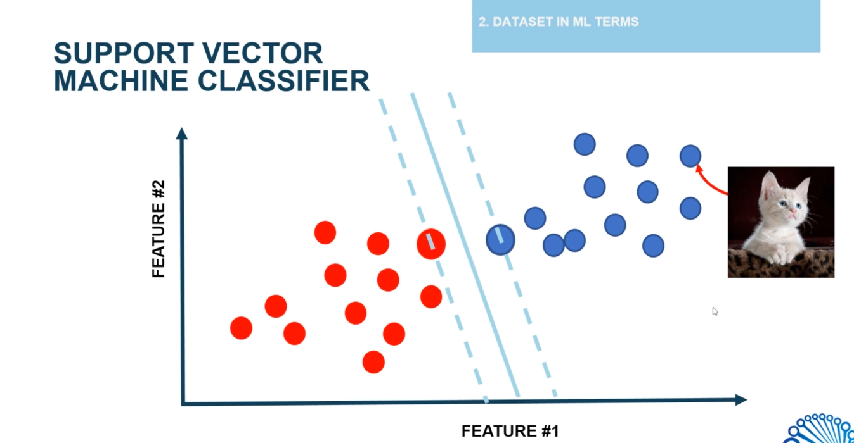
SUPPORT VECTOR MACHINE CLASSIFIER

Slide 10
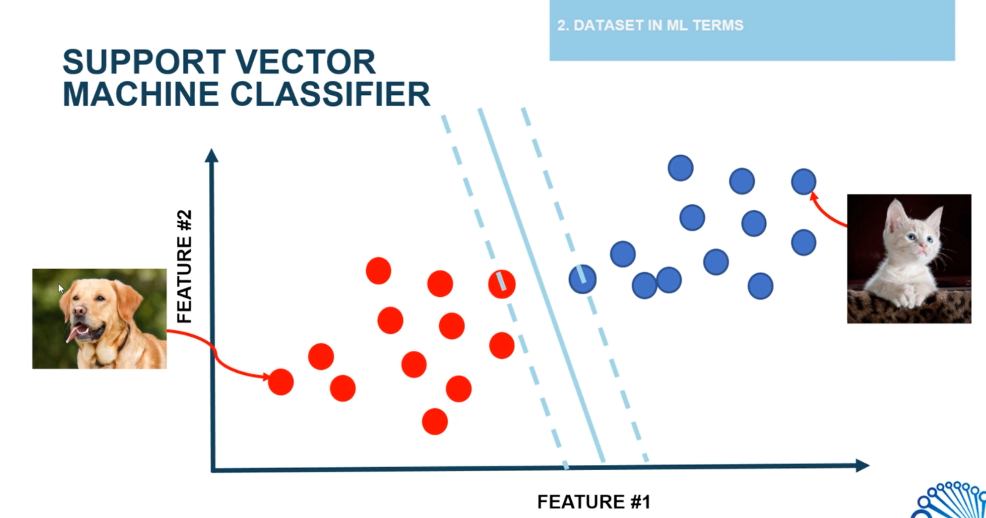
SUPPORT VECTOR MACHINE CLASSIFIER

Slide 11
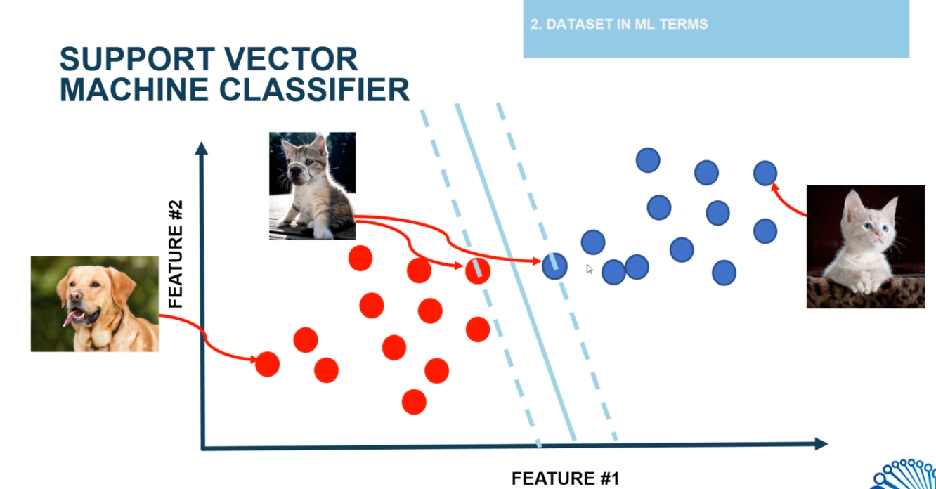
SUPPORT VECTOR MACHINE CLASSIFIER

Slide 12
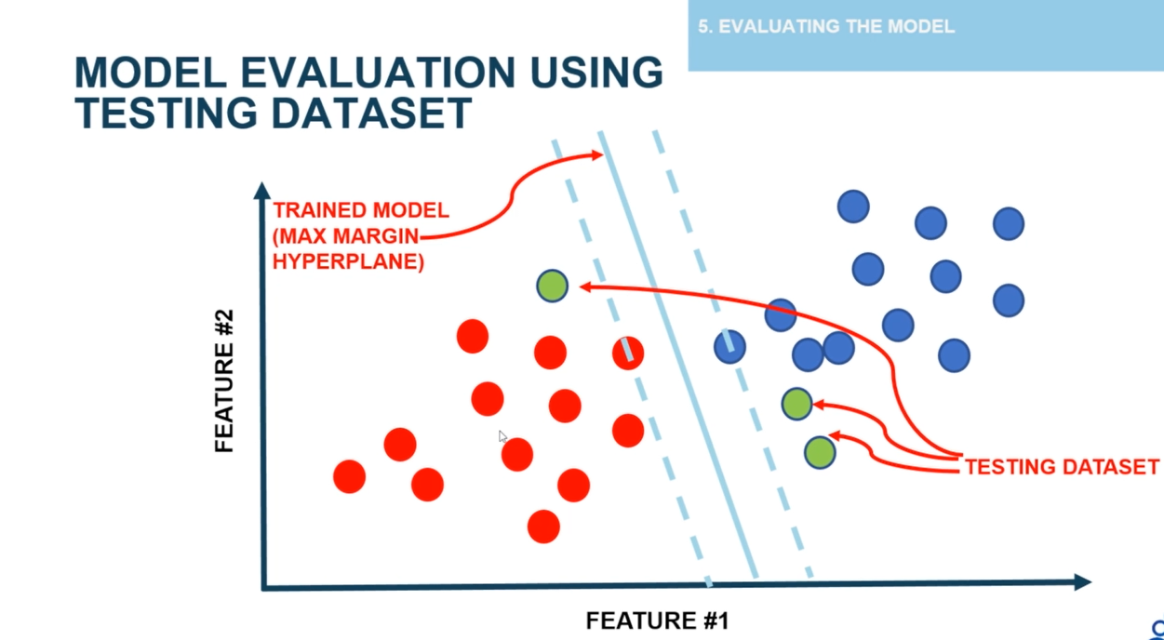
MODEL EVALUATING USING TESTING DATA

Slide 13
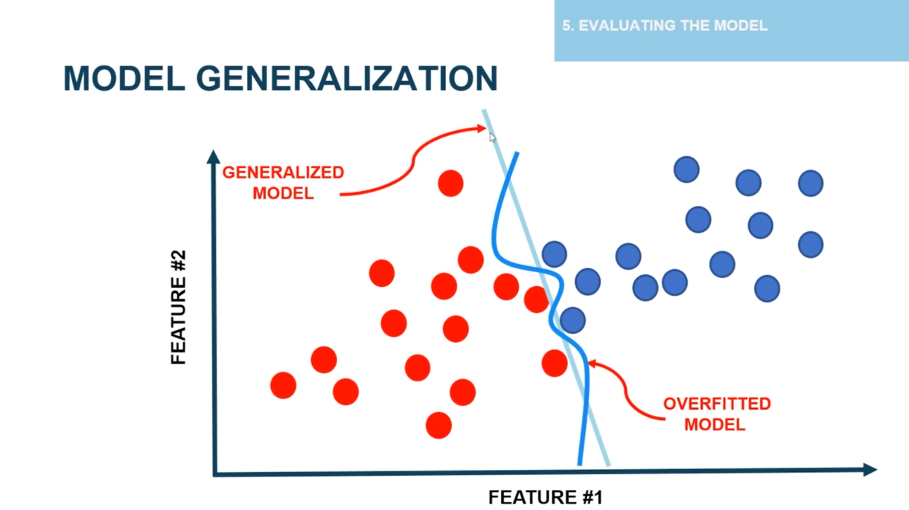
MODEL GENERALIZATION

Slide 14
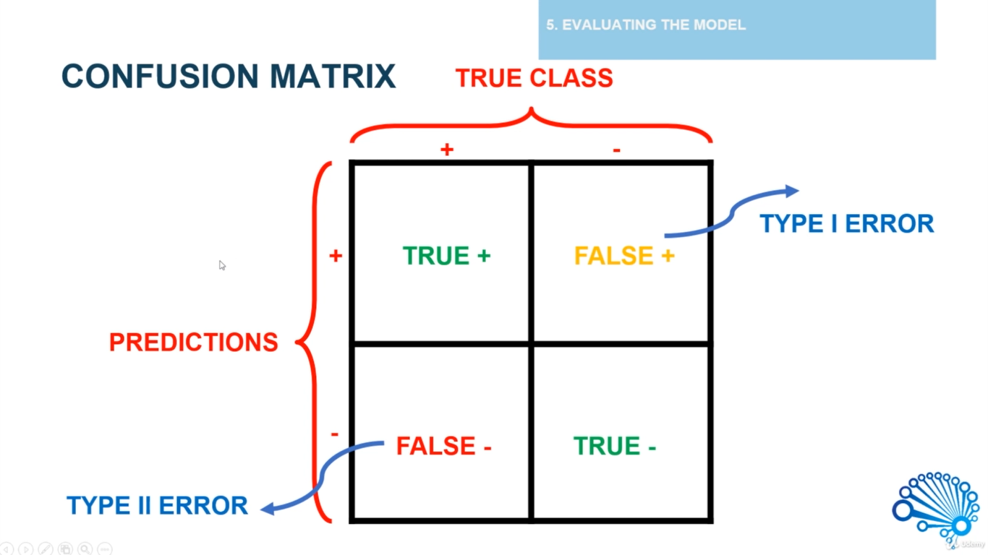
CONFUSION MATRIX

Slide 15
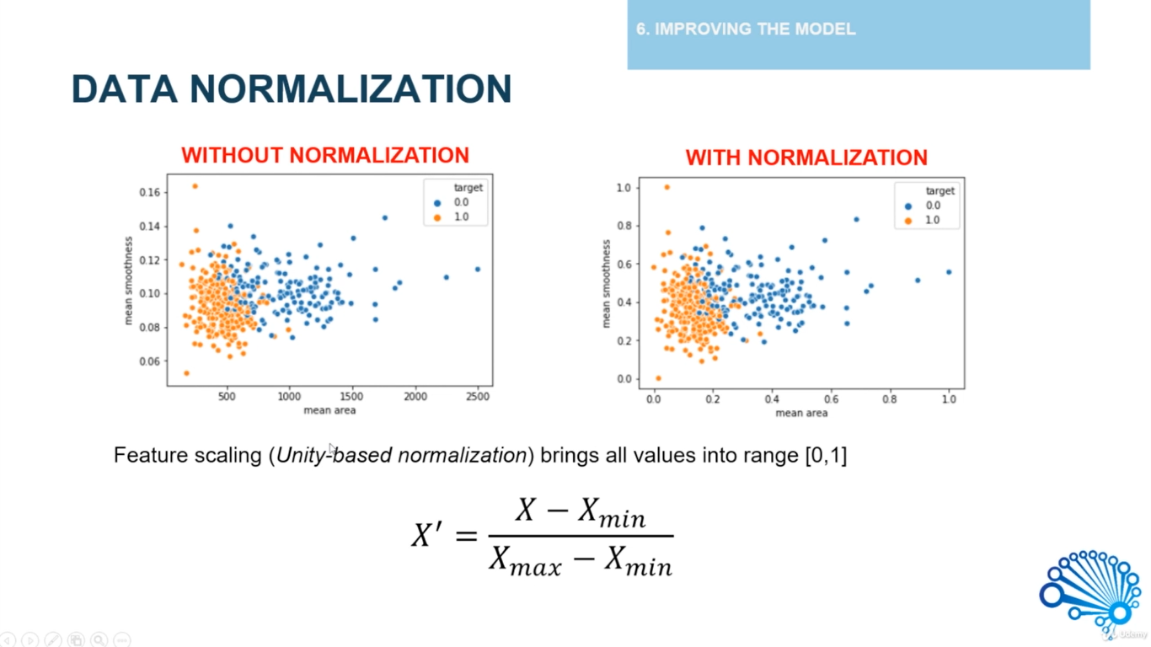
IMPROVING THE MODEL

Slide 16
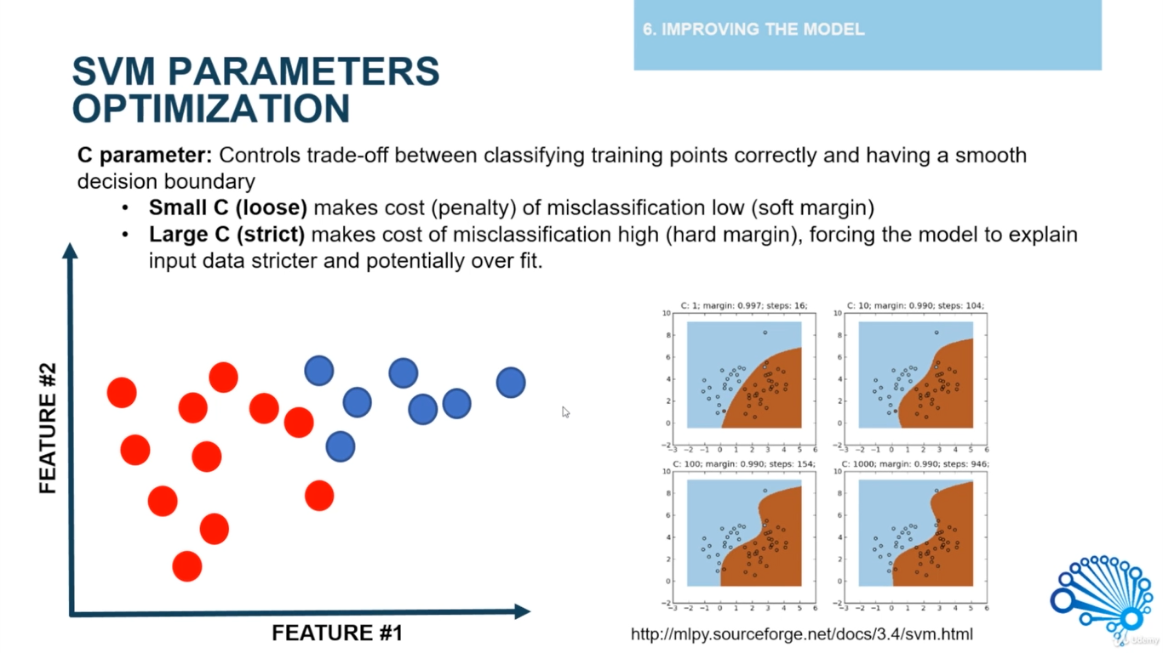
IMPROVING THE MODEL

Slide 17
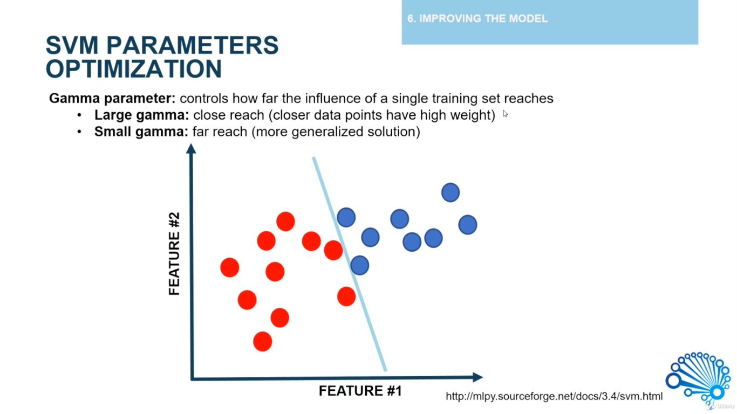
IMPROVING THE MODEL

Slide 18
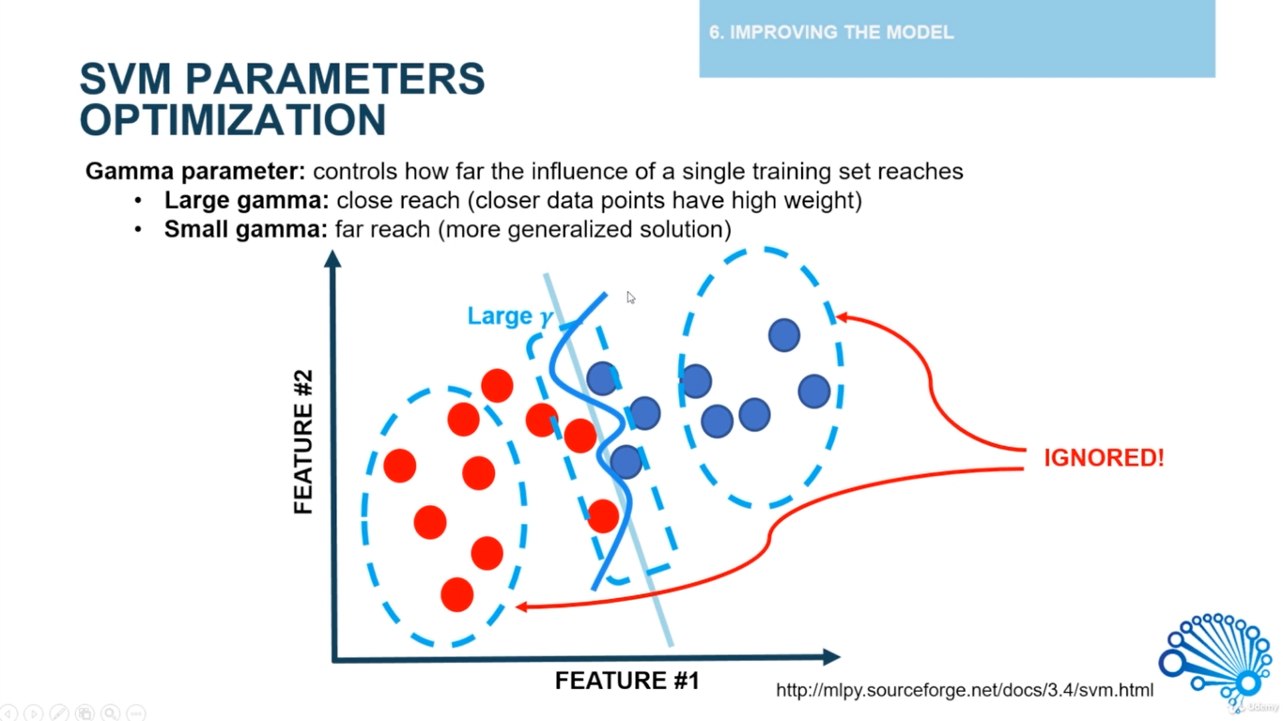
IMPROVING THE MODEL (Large gamma)

Slide 19
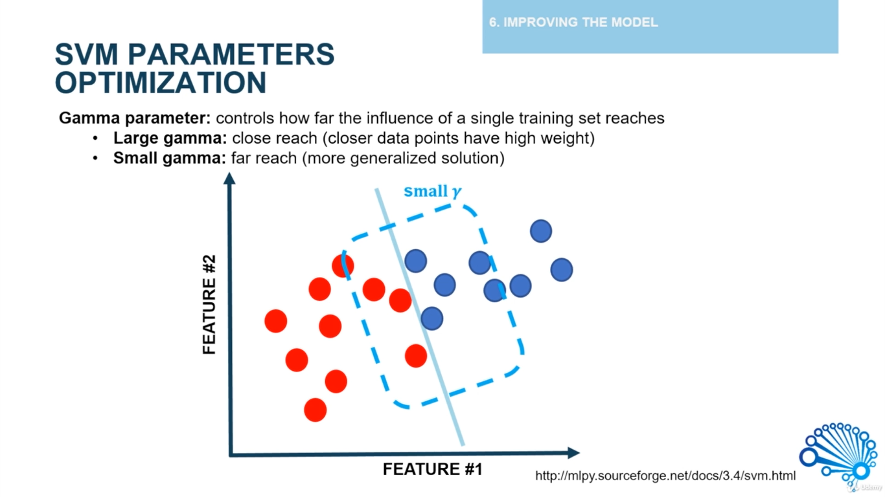
IMPROVING THE MODEL (Small gamma)

Slide 20
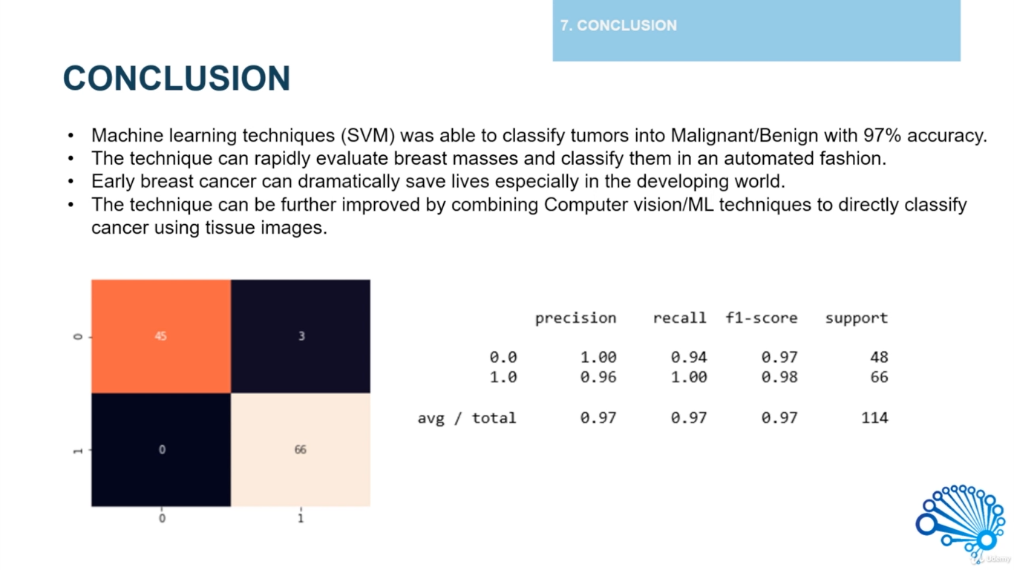
CONCLUSION

